Slide 1
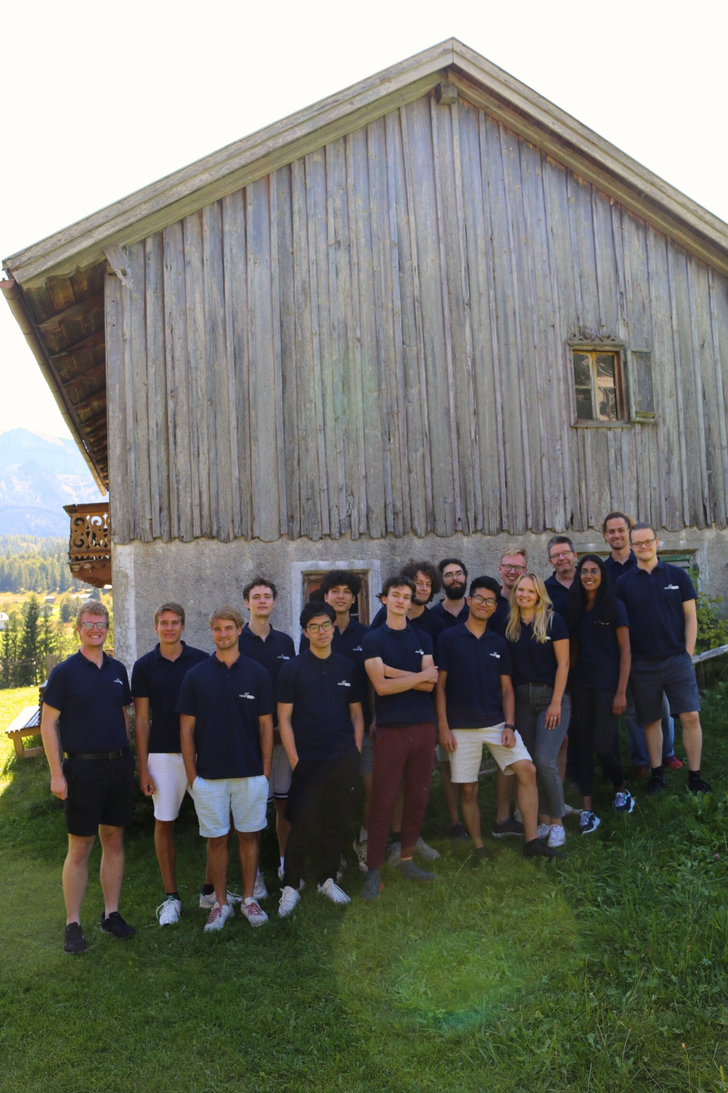






Wir entwickeln die Zukunft
mit innovativen Projekten für Startups & Mittelstand
Wir entwickeln SaaS-Plattformen,
Apps und KI basierte Tools mit extremen Nutzerfokus.
Mit unserem Entwicklerteam in München und der starken
Bindung zur TUM sind wir technologisch am Zahn der Zeit.
Ein paar unserer Kunden:
2017
20
10+
Gründung
Teammitglieder
Projekte
Notes:
Huhu :wave:
Wie gehts dir heute Julian? Also mit gehts super!

Slide 2



Das SelectCode Flutter-Team
entwickelt Apps, die auf der ganzen Welt genutzt werden
Julian Hartl
Niclas Schümann
Kerim Anater
Full Stack Developer
Projekt Manager | App Developer
App Developer

Slide 3
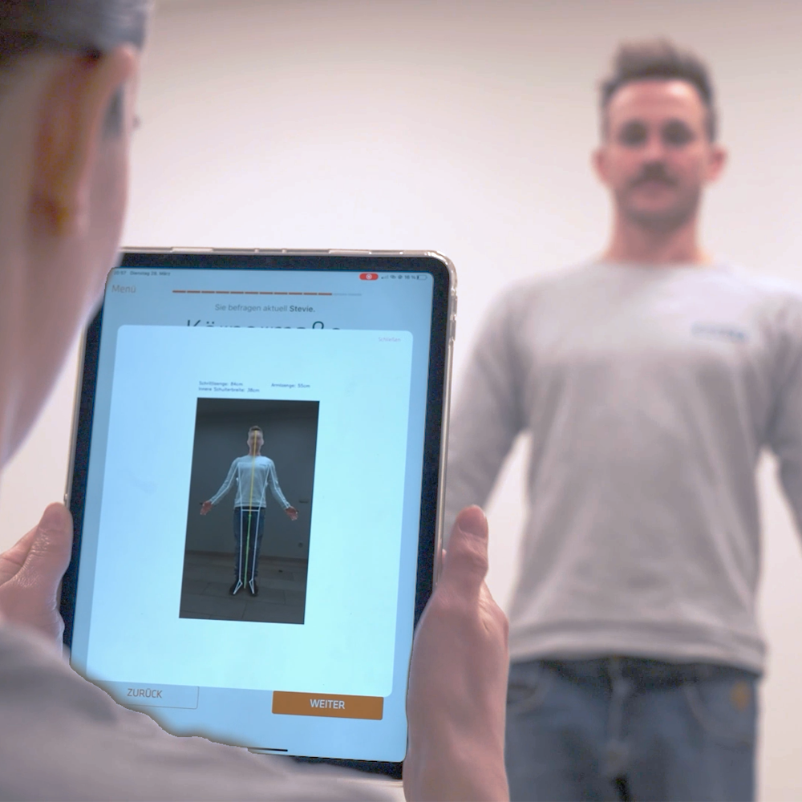

SQlab Profiler
Case Study
iPad App zur 3D-Vermessung und Bestimmung von passenden Sattel, Griff, etc.
über 500 Händler in DE, AT, CH, FR, USA
über 15.000 Vermessungen
MVP nach 2 Monaten
Top Features
3D-Vermessung
Digitale Befragung
Ergonomieprofil
Ein Produkt für

Slide 4
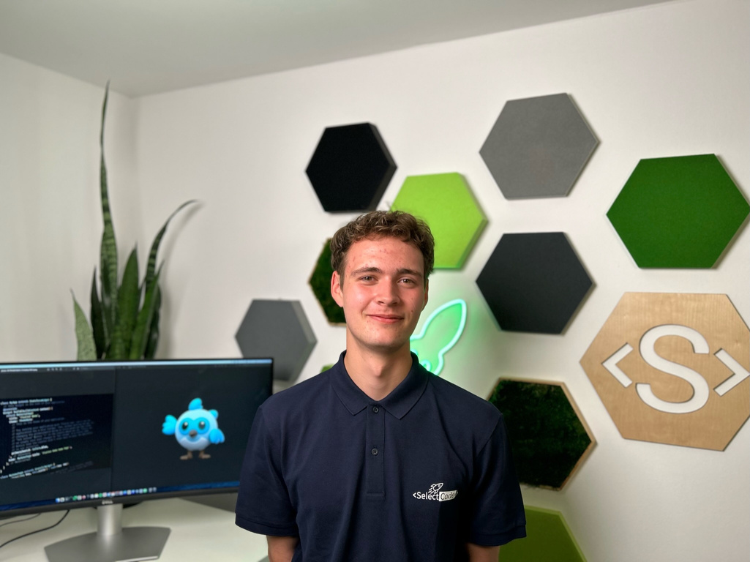
Das bin ich
Julian
3. Semester Bachelor Informatik @ TUM
Software Engineer bei der SelectCode seit 1,5 Jahren
Im Moment: Full Stack Entwicklung
Davor: Hauptsächlich Flutter

Slide 5

Flutter-Workshop
Julian Hartl

Slide 6
Overview
Why Flutter?
Flutter Basics
Dart Crash-Course
Developing a Shopping List app
Building your own app
Outlook

Slide 7
Why Flutter?

Slide 8
What even is Flutter?

Slide 9
What even is Flutter?
“Flutter is an open source framework by Google for building beautiful, natively compiled, multi-platform applications from a single codebase.”

Slide 10
What even is Flutter?
“Flutter is an open source framework by Google for building beautiful, natively compiled, multi-platform applications from a single codebase.”
Open source UI software development toolkit
Supports many platforms
Single codebase

Slide 11

Your experience with mobile development
Notes:
Was sind eure Erfahrung mit App Entwicklung?
Was erhofft ihr euch von diesem Workshop?

Slide 12
What does Flutter offer?

Slide 13
What does Flutter offer?
Cross-Platform development (Android, iOS, Web, Windows, macOS, Linux, Fuchsia)

Slide 14
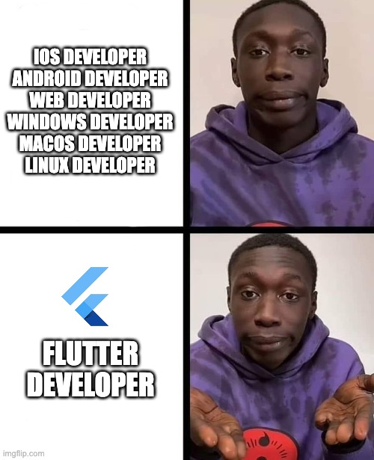
What does Flutter offer?
Cross-Platform development (Android, iOS, Web, Windows, macOS, Linux, Fuchsia)

Slide 15
What does Flutter offer?
Cross-Platform development (Android, iOS, Web, Windows, macOS, Linux, Fuchsia)
Performant due to Ahead-of-Time (AOT) Compilation

Slide 16
What does Flutter offer?
Cross-Platform development (Android, iOS, Web, Windows, macOS, Linux, Fuchsia)
Performant due to Ahead-of-Time (AOT) Compilation
Expressive and flexible UI (large set of prebuilt components)

Slide 17
What does Flutter offer?
Cross-Platform development (Android, iOS, Web, Windows, macOS, Linux, Fuchsia)
Performant due to Ahead-of-Time (AOT) Compilation
Expressive and flexible UI (large set of prebuilt components)
Hot reload (instant UI updates)

Slide 18
What does Flutter offer?
Cross-Platform development (Android, iOS, Web, Windows, macOS, Linux, Fuchsia)
Performant due to Ahead-of-Time (AOT) Compilation
Expressive and flexible UI (large set of prebuilt components)
Hot reload (instant UI updates)
Consistent behavior across all platforms

Slide 19

What does Flutter offer?
Cross-Platform development (Android, iOS, Web, Windows, macOS, Linux, Fuchsia)
Performant due to Ahead-of-Time (AOT) Compilation
Expressive and flexible UI (large set of prebuilt components)
Hot reload (instant UI updates)
Consistent behavior across all platforms

Slide 20
What does Flutter offer?
Cross-Platform development (Android, iOS, Web, Windows, macOS, Linux, Fuchsia)
Performant due to Ahead-of-Time (AOT) Compilation
Expressive and flexible UI (large set of prebuilt components)
Hot reload (instant UI updates)
Consistent behavior across all platforms
Strong community and ecosystem (wide adoption in the industry)

Slide 21
Applications in the wild

Slide 22

BMW
Feature and design discrepancies between their iOS and Android offering had grown too large
💭 Not yet mature enough
✅ Not web based => better UX
✅ Build & design once

Slide 23
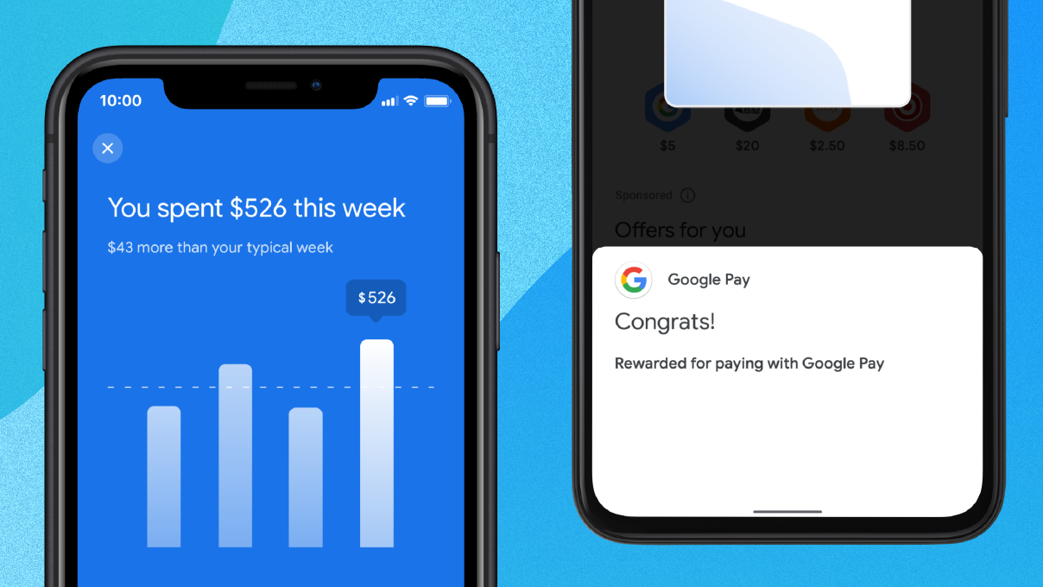
Google-Pay
Building every feature twice
💭 Heavy upfront investment of engineering resources (retraining, reapproval, …)
✅ 70% reduction in engineering effort
✅ 35% reduction in lines of code
✅ Saved about 60-70% of their engineer’s time

Slide 24
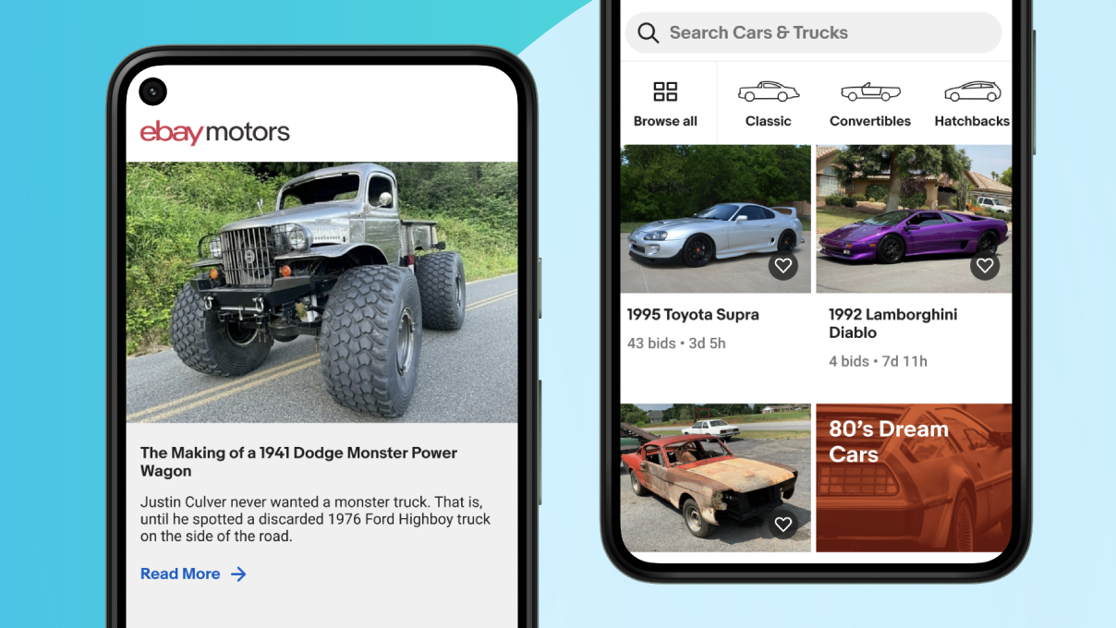
eBay
Building a new app to buy and sell hard-to-find cars for both Android and iOS in under a year
✅ Time-saving and design capabilities
✅ Hot reload
✅ Built-in testing
✅ Code sharing

Slide 25
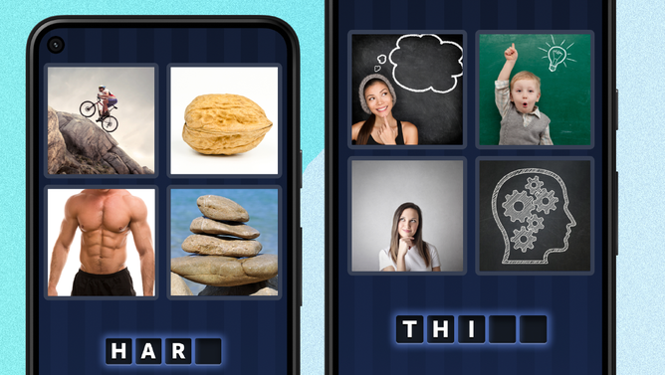
4 Pics 1 Word
Giving 4 Pics 1 Word a tuneup
✅ No more troubleshooting cross-platform functionality
✅ Performs offline on low-end devices
✅ 99.9% crash-free rate

Slide 26

Summary
Build once for all platforms
Native performance
Rich ecosystem & wide adoption

Slide 27
Flutter Basics

Slide 28
Widgets

Slide 29
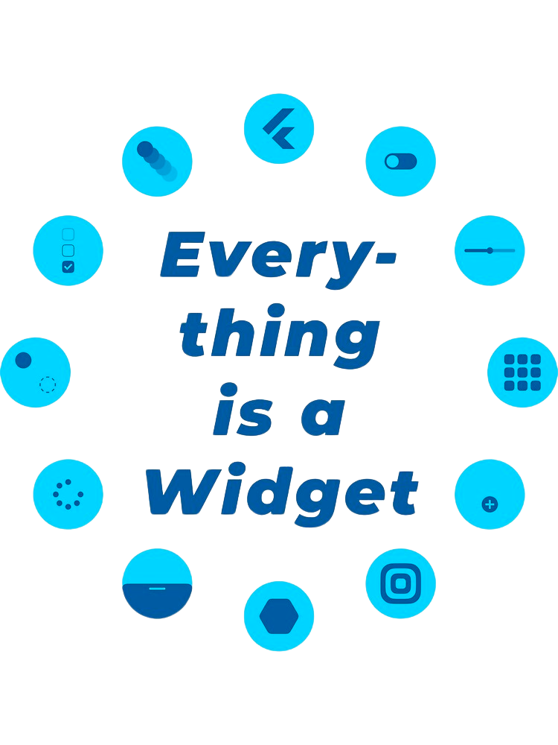
Notes:
jeder Screen besteht aus einer Vielzahl an Widgets

Slide 30
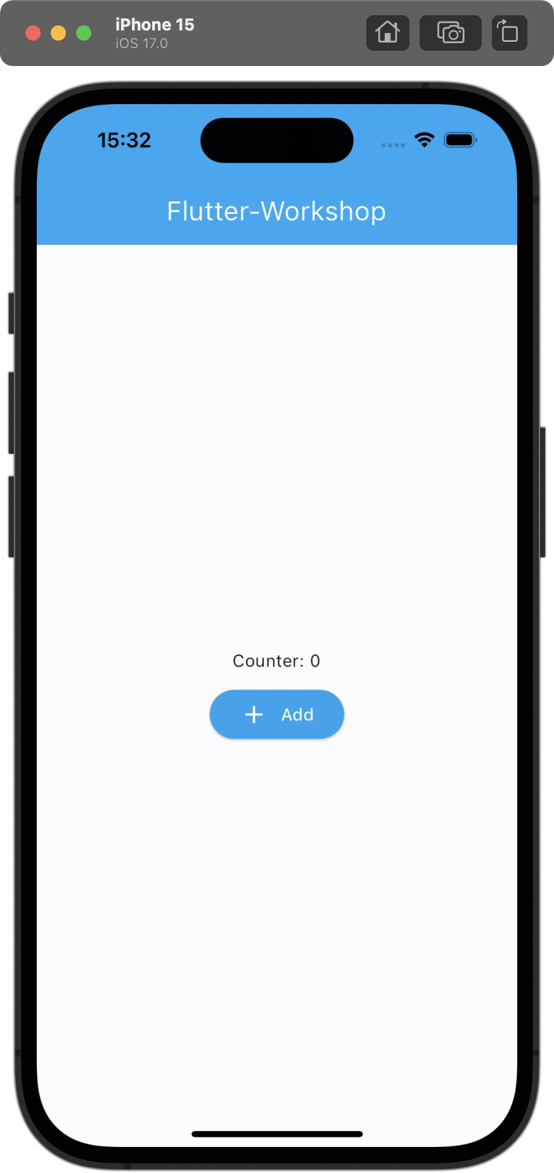

Slide 31
Root Widget

Slide 32
Root Widget

Slide 33
Root Widget
AppBar Widget

Slide 34
Root Widget
AppBar Widget
Text Widget

Slide 35
Root Widget
AppBar Widget
Center Widget
Text Widget

Slide 36
Root Widget
AppBar Widget
Center Widget
Text Widget
Column Widget

Slide 37
Root Widget
AppBar Widget
Center Widget
Text Widget
Column Widget
Text Widget

Slide 38
Root Widget
AppBar Widget
Center Widget
Text Widget
Column Widget
Text Widget
ElevatedButton Widget

Slide 39
Root Widget
AppBar Widget
Center Widget
Column Widget
Text Widget
ElevatedButton Widget
Text Widget
Row Widget

Slide 40
Root Widget
AppBar Widget
Center Widget
Column Widget
Text Widget
ElevatedButton Widget
Text Widget
Row Widget
Icon Widget

Slide 41
Root Widget
AppBar Widget
Center Widget
Column Widget
Text Widget
ElevatedButton Widget
Text Widget
Row Widget
Icon Widget
Text Widget

Slide 42
Root Widget
AppBar Widget
Center Widget
Column Widget
Text Widget
ElevatedButton Widget
Text Widget
Row Widget
Icon Widget
Text Widget

Slide 43
Chat-GPT Clone
Notes:
iPad herumgeben!!!

Slide 44
Demo
Chat-GPT Clone
Notes:
iPad herumgeben!!!

Slide 45
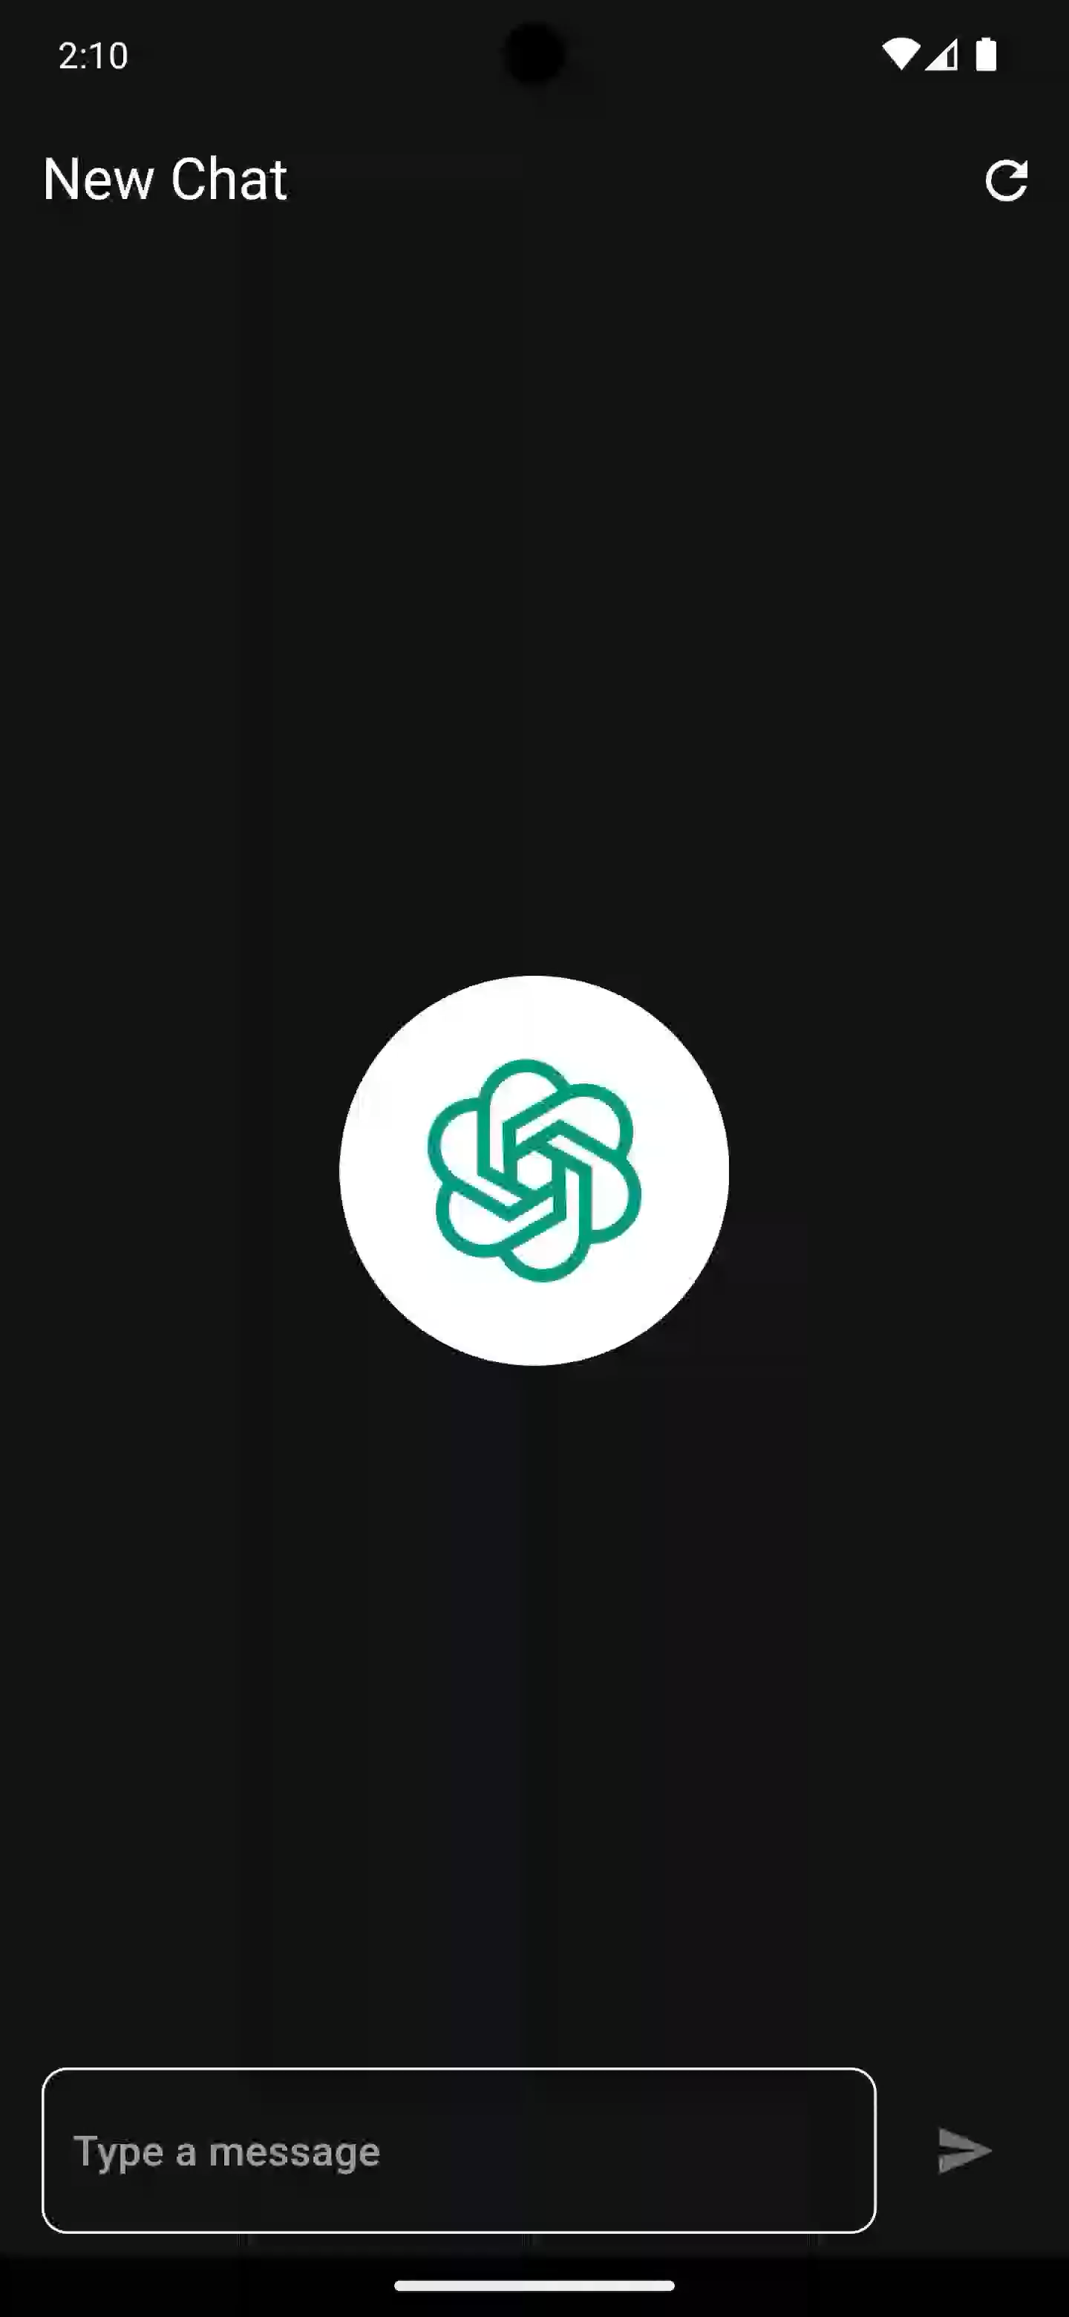


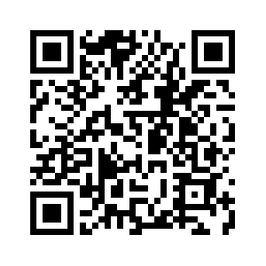


Slide 46
Architecture
Chat-GPT Clone

Slide 47


Authorize users
Authenticate
Chat CRUD

Slide 48
Design
Chat-GPT Clone

Slide 49
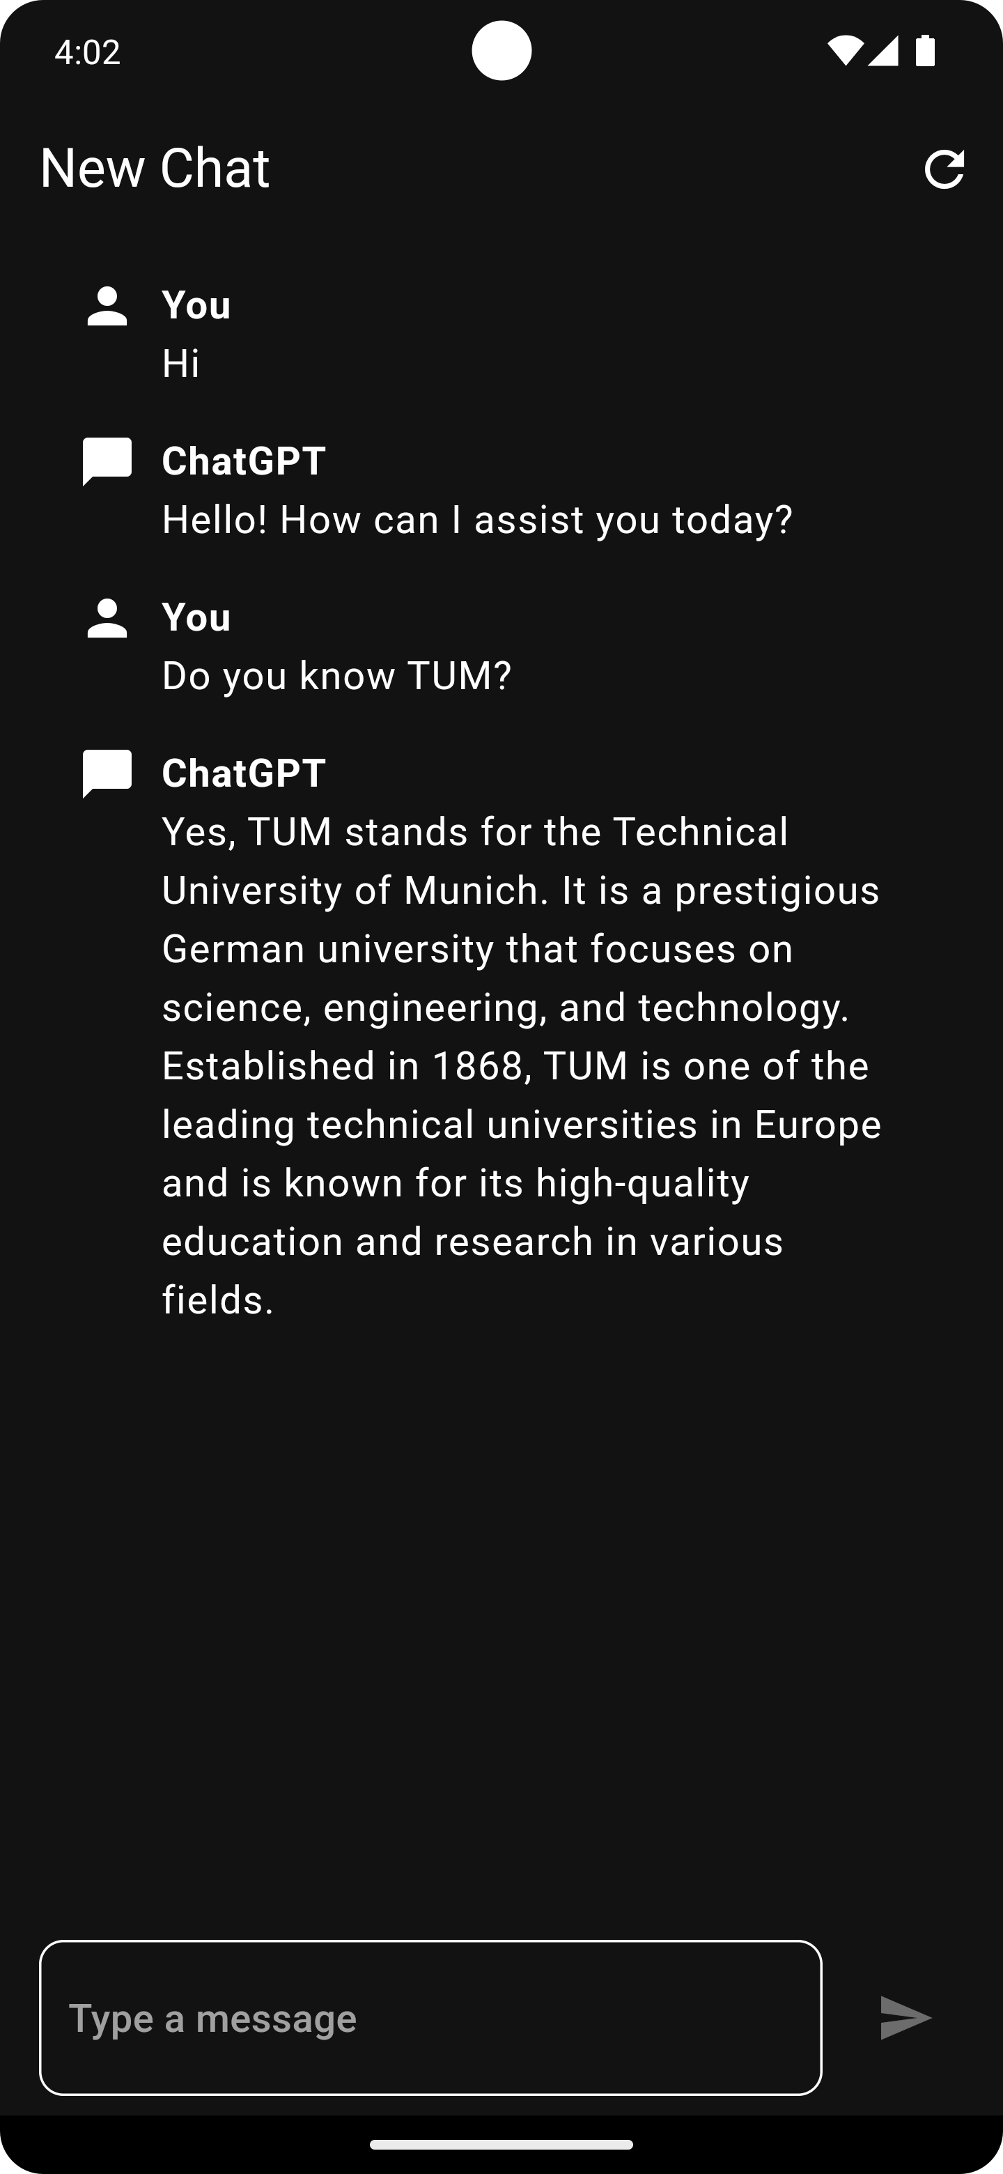

Slide 53
Flutter Inspector

Slide 56
class ChatInput extends StatefulWidget { const ChatInput({super.key}); @override State<ChatInput> createState() => _ChatInputState(); } class _ChatInputState extends State<ChatInput> { final TextEditingController _inputController = TextEditingController(); @override void dispose() { super.dispose(); _inputController.dispose(); } @override Widget build(BuildContext context) { return Row( children: [], ); } }

Slide 57
class ChatInput extends StatefulWidget { const ChatInput({super.key}); @override State<ChatInput> createState() => _ChatInputState(); } class _ChatInputState extends State<ChatInput> { final TextEditingController _inputController = TextEditingController(); @override void dispose() { super.dispose(); _inputController.dispose(); } @override Widget build(BuildContext context) { return Row( children: [], ); } }
A StatefulWidget is a widget has mutable state.

Slide 58
A StatefulWidget is a widget has mutable state.
class ChatInput extends StatefulWidget { const ChatInput({super.key}); @override State<ChatInput> createState() => _ChatInputState(); } class _ChatInputState extends State<ChatInput> { final TextEditingController _inputController = TextEditingController(); @override void dispose() { super.dispose(); _inputController.dispose(); } @override Widget build(BuildContext context) { return Row( children: [], ); } }
You can create this boilerplate using the stful live template

Slide 59
class ChatInput extends StatefulWidget { const ChatInput({super.key}); @override State<ChatInput> createState() => _ChatInputState(); } class _ChatInputState extends State<ChatInput> { final TextEditingController _inputController = TextEditingController(); @override void dispose() { super.dispose(); _inputController.dispose(); } @override Widget build(BuildContext context) { return Row( children: [], ); } }

Slide 60
@override Widget build(BuildContext context) { return Row( children: [], ); }

Slide 61
@override Widget build(BuildContext context) { return Row( children: [ Expanded( child: TextFormField( controller: _inputController, decoration: const InputDecoration( hintText: 'Type a message', ), ), ), const SizedBox( width: 10, ), ListenableBuilder( listenable: _inputController, builder: (context, _) { return IconButton( onPressed: _inputController.text.isEmpty ? null : onSendPressed, icon: const Icon(Icons.send), ); }, ), ], ); }

Slide 62
@override Widget build(BuildContext context) { return Row( children: [ Expanded( child: TextFormField( controller: _inputController, decoration: const InputDecoration( hintText: 'Type a message', ), ), ), const SizedBox( width: 10, ), ListenableBuilder( listenable: _inputController, builder: (context, _) { return IconButton( onPressed: _inputController.text.isEmpty ? null : onSendPressed, icon: const Icon(Icons.send), ); }, ), ], ); }
👈 Expand TextFormField to its maximum size

Slide 63
@override Widget build(BuildContext context) { return Row( children: [ Expanded( child: TextFormField( controller: _inputController, decoration: const InputDecoration( hintText: 'Type a message', ), ), ), const SizedBox( width: 10, ), ListenableBuilder( listenable: _inputController, builder: (context, _) { return IconButton( onPressed: _inputController.text.isEmpty ? null : onSendPressed, icon: const Icon(Icons.send), ); }, ), ], ); }
👈 Expand TextFormField to its maximum size
👈 Rebuild IconButton when input changes

Slide 64
@override Widget build(BuildContext context) { return Row( children: [ Expanded( child: TextFormField( controller: _inputController, decoration: const InputDecoration( hintText: 'Type a message', ), ), ), const SizedBox( width: 10, ), ListenableBuilder( listenable: _inputController, builder: (context, _) { return IconButton( onPressed: _inputController.text.isEmpty ? null : onSendPressed, icon: const Icon(Icons.send), ); }, ), ], ); }
👈 Expand TextFormField to its maximum size
👈 Rebuild IconButton when input changes
Disable button when input is empty 👆

Slide 65
@override Widget build(BuildContext context) { return Row( children: [ Expanded( child: TextFormField( controller: _inputController, decoration: const InputDecoration( hintText: 'Type a message', ), ), ), const SizedBox( width: 10, ), if (_isSending) const CircularProgressIndicator() else ListenableBuilder( listenable: _inputController, builder: (context, _) { return IconButton( onPressed: _inputController.text.isEmpty ? null : onSendPressed, icon: const Icon(Icons.send), ); }, ), ], ); }
👈 Show progress indicator while sending a message

Slide 66
bool _isSending = false; void onSendPressed() async { try { setState(() { _isSending = true; }); final chatProvider = context.read<ChatProvider>(); await chatProvider.sendMessage( _inputController.text.trim(), ); _inputController.clear(); await chatProvider.requestResponse(); } finally { setState(() { _isSending = false; }); } }

Slide 67
bool _isSending = false; void onSendPressed() async { try { setState(() { _isSending = true; }); final chatProvider = context.read<ChatProvider>(); await chatProvider.sendMessage( _inputController.text.trim(), ); _inputController.clear(); await chatProvider.requestResponse(); } finally { setState(() { _isSending = false; }); } }
👈 Rebuild children with updated state

Slide 68
class ChatInput extends StatefulWidget { const ChatInput({super.key}); @override State<ChatInput> createState() => _ChatInputState(); } class _ChatInputState extends State<ChatInput> { final TextEditingController _inputController = TextEditingController(); @override void dispose() { super.dispose(); _inputController.dispose(); } bool _isSending = false; void onSendPressed() async { try { setState(() { _isSending = true; }); final chatProvider = context.read<ChatProvider>(); await chatProvider.sendMessage( _inputController.text.trim(), ); _inputController.clear(); await chatProvider.requestResponse(); } finally { setState(() { _isSending = false; }); } }
@override Widget build(BuildContext context) { return Row( children: [ Expanded( child: TextFormField( controller: _inputController, decoration: const InputDecoration( hintText: 'Type a message', ), ), ), const SizedBox( width: 10, ), if (_isSending) const CircularProgressIndicator() else ListenableBuilder( listenable: _inputController, builder: (context, _) { return IconButton( onPressed: _inputController.text.isEmpty ? null : onSendPressed, icon: const Icon(Icons.send), ); }, ), ], ); } }

Slide 71
class ChatDisplay extends StatelessWidget { const ChatDisplay({super.key, required this.chat}); final Chat chat; @override Widget build(BuildContext context) { return ListView.builder( itemBuilder: (context, index) { final message = chat.messages[index]; return ChatMessageTile(message: message); }, itemCount: chat.messages.length, ); } }

Slide 72
class ChatDisplay extends StatelessWidget { const ChatDisplay({super.key, required this.chat}); final Chat chat; @override Widget build(BuildContext context) { return ListView.builder( itemBuilder: (context, index) { final message = chat.messages[index]; return ChatMessageTile(message: message); }, itemCount: chat.messages.length, ); } }
👈 Build Widget for each message

Slide 73
class ChatMessageTile extends StatelessWidget { const ChatMessageTile({ super.key, required this.message, }); final ChatMessage message; @override Widget build(BuildContext context) { return ListTile( ); } }

Slide 74
@override Widget build(BuildContext context) { return ListTile( title: Row( crossAxisAlignment: CrossAxisAlignment.start, children: [ if (message.sender == Sender.user) const Icon(Icons.person) else const Icon(Icons.chat_bubble), const SizedBox( width: 10, ), Expanded( child: Column( crossAxisAlignment: CrossAxisAlignment.start, children: [ Text( message.sender.displayText, style: const TextStyle( fontWeight: FontWeight.bold, ), ), Text(message.text), ], ), ), ], ), ); }
👈 Choose icon depending on sender

Slide 75
@override Widget build(BuildContext context) { return ListTile( title: Row( crossAxisAlignment: CrossAxisAlignment.start, children: [ if (message.sender == Sender.user) const Icon(Icons.person) else const Icon(Icons.chat_bubble), const SizedBox( width: 10, ), Expanded( child: Column( crossAxisAlignment: CrossAxisAlignment.start, children: [ Text( message.sender.displayText, style: const TextStyle( fontWeight: FontWeight.bold, ), ), Text(message.text), ], ), ), ], ), ); }
👈 Choose icon depending on sender
👈 Horizontal space
Align Texts to the left 👆

Slide 76
@override Widget build(BuildContext context) { return ListTile( title: Row( crossAxisAlignment: CrossAxisAlignment.start, children: [ if (message.sender == Sender.user) const Icon(Icons.person) else const Icon(Icons.chat_bubble), const SizedBox( width: 10, ), Expanded( child: Column( crossAxisAlignment: CrossAxisAlignment.start, children: [ Text( message.sender.displayText, style: const TextStyle( fontWeight: FontWeight.bold, ), ), Text(message.text), ], ), ), ], ), ); }
👈 Choose icon depending on sender
👈 Horizontal space
Align Texts to the left 👆
Make sender name bold 👆

Slide 77
class ChatDisplay extends StatelessWidget { const ChatDisplay({super.key, required this.chat}); final Chat chat; @override Widget build(BuildContext context) { if (chat.messages.isEmpty) { return Center( child: ConstrainedBox( constraints: const BoxConstraints( maxWidth: 300, ), child: const FractionallySizedBox( widthFactor: 0.5, child: Image( image: AssetImage('assets/images/chatgpt.png'), ), ), ), ); } return ListView.builder( itemBuilder: (context, index) { final message = chat.messages[index]; return ChatMessageTile(message: message); }, itemCount: chat.messages.length, ); } }
class ChatMessageTile extends StatelessWidget { const ChatMessageTile({ super.key, required this.message, }); final ChatMessage message; @override Widget build(BuildContext context) { return ListTile( title: Row( crossAxisAlignment: CrossAxisAlignment.start, children: [ if (message.sender == Sender.user) const Icon(Icons.person) else const Icon(Icons.chat_bubble), const SizedBox( width: 10, ), Expanded( child: Column( crossAxisAlignment: CrossAxisAlignment.start, children: [ Text( message.sender.displayText, style: const TextStyle( fontWeight: FontWeight.bold, ), ), Text(message.text), ], ), ), ], ), ); } }

Slide 80
AppBar buildAppBar(Chat? chat, BuildContext context) { return AppBar( title: Text(chat?.title ?? 'ChatGPT'), actions: [ IconButton( onPressed: () async { await context.read<ChatProvider>().startNewChat(); }, icon: const Icon(Icons.refresh), ), ], ); }

Slide 81
AppBar buildAppBar(Chat? chat, BuildContext context) { return AppBar( title: Text(chat?.title ?? 'ChatGPT'), actions: [ IconButton( onPressed: () async { await context.read<ChatProvider>().startNewChat(); }, icon: const Icon(Icons.refresh), ), ], ); }
👆 Null operator

Slide 83
class Home extends StatefulWidget { const Home({super.key}); @override State<Home> createState() => _HomeState(); } class _HomeState extends State<Home> { @override Widget build(BuildContext context) { } AppBar buildAppBar(Chat? chat, BuildContext context) { ... } }

Slide 84
@override Widget build(BuildContext context) { final chatProvider = context.watch<ChatProvider>(); final chat = chatProvider.currentChat; return Scaffold( appBar: buildAppBar(chat, context), body: SafeArea( child: Padding( padding: const EdgeInsets.symmetric(horizontal: 16, vertical: 8), child: Column( children: [ Expanded( child: chat == null ? const Center( child: CircularProgressIndicator(), ) : ChatDisplay(chat: chat), ), const ChatInput(), ], ), ), ), ); }

Slide 85
@override Widget build(BuildContext context) { final chatProvider = context.watch<ChatProvider>(); final chat = chatProvider.currentChat; return Scaffold( appBar: buildAppBar(chat, context), body: SafeArea( child: Padding( padding: const EdgeInsets.symmetric(horizontal: 16, vertical: 8), child: Column( children: [ Expanded( child: chat == null ? const Center( child: CircularProgressIndicator(), ) : ChatDisplay(chat: chat), ), const ChatInput(), ], ), ), ), ); }
👈 Applies padding to child

Slide 86
@override Widget build(BuildContext context) { final chatProvider = context.watch<ChatProvider>(); final chat = chatProvider.currentChat; return Scaffold( appBar: buildAppBar(chat, context), body: SafeArea( child: Padding( padding: const EdgeInsets.symmetric(horizontal: 16, vertical: 8), child: Column( children: [ Expanded( child: chat == null ? const Center( child: CircularProgressIndicator(), ) : ChatDisplay(chat: chat), ), const ChatInput(), ], ), ), ), ); }
👈 Applies padding to child

Slide 87
class Home extends StatefulWidget { const Home({super.key}); @override State<Home> createState() => _HomeState(); } class _HomeState extends State<Home> { @override void initState() { super.initState(); WidgetsBinding.instance.addPostFrameCallback((_) { final authProvider = context.read<AuthProvider>(); VoidCallback? listener; listener = () { if (authProvider.currentUser == null) { return; } final chatProvider = context.read<ChatProvider>(); chatProvider.loadCurrentOrCreateChat(); authProvider.removeListener(listener!); }; authProvider.addListener(listener); }); } AppBar buildAppBar(Chat? chat, BuildContext context) { return AppBar( title: Text(chat?.title ?? 'ChatGPT'), actions: [ IconButton( onPressed: () async { await context.read<ChatProvider>().startNewChat(); }, icon: const Icon(Icons.refresh), ), ], ); } }
@override Widget build(BuildContext context) { final authProvider = context.watch<AuthProvider>(); if (authProvider.currentUser == null) { return const Scaffold( body: Center( child: CircularProgressIndicator(), ), ); } final chatProvider = context.watch<ChatProvider>(); final chat = chatProvider.currentChat; return Scaffold( appBar: buildAppBar(chat, context), body: SafeArea( child: Padding( padding: const EdgeInsets.symmetric(horizontal: 16, vertical: 8), child: Column( children: [ Expanded( child: chat == null ? const Center( child: CircularProgressIndicator(), ) : ChatDisplay(chat: chat), ), const ChatInput(), ], ), ), ), ); }

Slide 88
class MyApp extends StatelessWidget { const MyApp({super.key, required this.dio}); final Dio dio; @override Widget build(BuildContext context) { return MultiProvider( providers: [ ChangeNotifierProvider( create: (_) => ChatProvider(dio), ), ChangeNotifierProvider( create: (_) => AuthProvider(dio), ), ], child: MaterialApp( home: const Home(), title: 'GDSC GPT', debugShowCheckedModeBanner: false, theme: gptTheme, ), ); } }

Slide 89
class MyApp extends StatelessWidget { const MyApp({super.key, required this.dio}); final Dio dio; @override Widget build(BuildContext context) { return MultiProvider( providers: [ ChangeNotifierProvider( create: (_) => ChatProvider(dio), ), ChangeNotifierProvider( create: (_) => AuthProvider(dio), ), ], child: MaterialApp( home: const Home(), title: 'GDSC GPT', debugShowCheckedModeBanner: false, theme: gptTheme, ), ); } }
👈 Create singletons that hold application logic

Slide 90
class MyApp extends StatelessWidget { const MyApp({super.key, required this.dio}); final Dio dio; @override Widget build(BuildContext context) { return MultiProvider( providers: [ ChangeNotifierProvider( create: (_) => ChatProvider(dio), ), ChangeNotifierProvider( create: (_) => AuthProvider(dio), ), ], child: MaterialApp( home: const Home(), title: 'GDSC GPT', debugShowCheckedModeBanner: false, theme: gptTheme, ), ); } }
👈 Create singletons that hold application logic
👈 Apply global theme

Slide 91
void main() async { WidgetsFlutterBinding.ensureInitialized(); final dio = Dio( BaseOptions( baseUrl: 'https://gpt.tunnelto.dev', ), ); await Firebase.initializeApp( options: DefaultFirebaseOptions.currentPlatform, ); runApp( MyApp( dio: dio, ), ); }

Slide 92
void main() async { WidgetsFlutterBinding.ensureInitialized(); final dio = Dio( BaseOptions( baseUrl: 'https://gpt.tunnelto.dev', ), ); await Firebase.initializeApp( options: DefaultFirebaseOptions.currentPlatform, ); runApp( MyApp( dio: dio, ), ); }
Setup firebase 👆

Slide 93


Slide 94
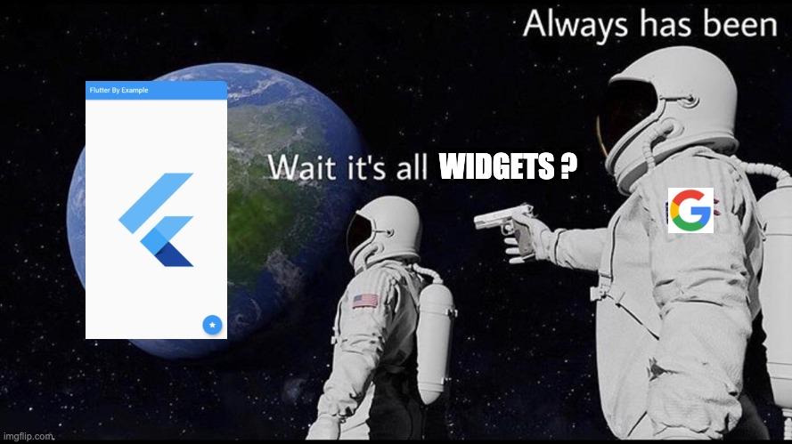
Summary

